Slide 1
HANA – A Collaborative Robot
It doesn't just avoid people — it understands them, and works alongside them.
David Wang · Justin Fang · Steven Qi · Heidi Wang | Electrical Engineering

Slide 2
BACKGROUND
Factory robots are fast but blind to people — so they get caged. We set out to build one that safely shares the workspace.
• The problem: traditional arms must be fenced off — no real human–robot teamwork, wasted floor space.
• Our focus: a robot that knows where the worker is, and what they intend.
• Built for TMMC: where 8,500 Team Members assemble the Lexus RX, NX & RAV4 alongside automation every day.

Slide 3
DESIGN CHOICES
One robot, five integrated modules, designed in three layers around the human.
• Layer 1 — Foundation: vision-guided pick & place into a container.
• Layer 2 — Tiered safety: a caution zone slows the arm, a danger zone stops it.
• Layer 3 — Handoff Protocol: hand present → deliver to the worker; no hand → place in the tray.
• Five modules: pick & place · hand-safety · operator monitor · manual control · web Control Center.
• Hand sensing: chose MediaPipe over color / motion — robust under changing factory light.

Slide 4
TECHNICAL ANALYSIS
From camera pixels to robot motion — calibrated, fast, and conservative on safety.
• Pipeline: Orbbec camera → 12-point homography (pixel → robot mm) → MediaPipe + HSV detection → zone / state logic → Dobot arm.
• Detection: red object finding tuned for distance; a circular metal tray is auto-located as the drop zone.
• Safety logic (Jidoka): every fingertip on up to two hands is checked each frame — the most dangerous zone wins.
• Performance: frame downscaling + CLAHE contrast keep detection near real-time for live control.

Slide 5
SAFETY
"Everything starts with safety" — engineered to recognized practice.
• Three zones: GREEN clear (full speed) · ORANGE caution (slow to 50%) · RED danger (full stop).
• Danger response: the robot halts immediately and auto-resumes 3 s after the hand clears.
• Standards: aligned to ISO/TS 15066 (speed & separation monitoring) and CSA Z434 (Canadian industrial robot safety).
• Fail-safe by default: any uncertainty → stop. The machine protects the human first.

Slide 6
HUMAN CENTRICITY
Hana is designed as the 8,501st team member — to assist, never to replace.
• Handoff Protocol: parts arrive in the worker's hand the moment they reach — Just-In-Time, at human scale.
• Operator monitor: a second camera recognizes the operator and flags drowsiness, micro-sleeps and yawns.
• Gesture aware: a peace sign pauses the robot and it waves back — natural, hands-free, worker-controlled.
• In control: the human keeps judgment; the robot takes the repetitive reach.

Slide 7
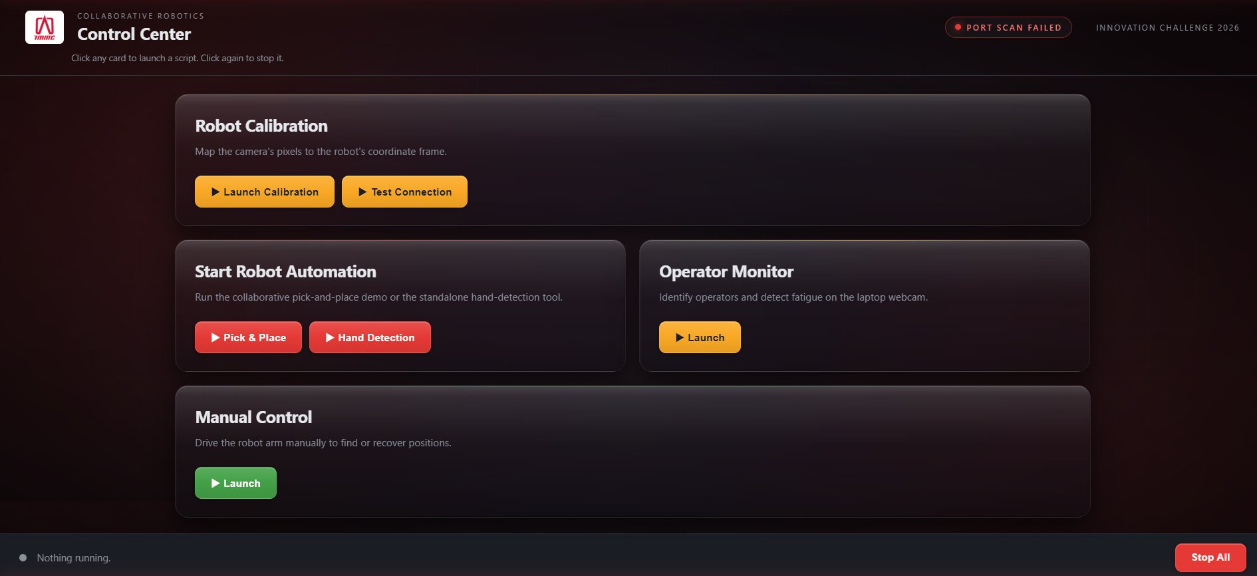
PROOF OF CONCEPT
A working prototype — and one Control Center that runs all of it.
• Vision-guided detection + automatic tray finding
• Picks every detected object, one after another
• Tiered safety zones + handoff to hand or tray
• Peace-sign gesture → pause & wave
• Operator ID + fatigue monitoring
• Web Control Center: one-click launch, no terminal
The web Control Center

Slide 8
COST ANALYSIS
Most of the cost is hardware we were given; the software is free.
• Largest costs: the Dobot Magician arm and the Orbbec depth camera (both provided).
• Software: 100% open-source — Python, OpenCV, MediaPipe — $0 licensing.
• No custom fabrication: reused the starter hardware as-is.
• Scales for free: the same code runs on a larger industrial arm with no rewrite.

Slide 9
NEXT STEPS
From a 48-hour prototype toward a plant-floor system.
• Orientation-aware grip: rotate the gripper to match a part's angle and grab irregular shapes.
• Depth-based 3D zones: replace 2D image regions with true 3D safety volumes.
• Mid-run manual takeover: let an operator seize control during automation at any moment.
• For industry: multi-camera coverage, consistent lighting, and ISO/TS 15066 certification.

